Slide 1
Progress
Model to estimate material parameters
Thermal camera measures radiative heat
Used to estimate temperature, power density and laser power.
Power Estimate
Generated different methods based off image processing techniques.
Designed to work on 2D data
Requires refinement
Historical Data Logging
Developed first version API to write to it
Basic features

Slide 2
Model
Laser Radius
r
Radiative Heat
Temperature
Power Density
Laser Power
Qr
T
I
P
Treating each pixel as a separate region of space
Thermal Camera Footage
Laser power is spread over a certain region

Slide 3
Model
Limitations:
Chain of approximations
Fitting functions to approximation of material parameters
Thermal Conductivity
Thermal Diffusivity
Specific Heat Capacity
Absorptivity
Tested on one data set
Black box

Slide 4
Historical Data Logging
HDF5 data format
Datasets: A N-dimensional collection of data
Groups: Collection of items including other groups
Attributes: Attached descriptive bits of information
E.g. description, date-time of creation, last time edited etc.
“Super” group: Large collection of other groups

Slide 5
File
Runs
{1…}
Predictions
Data
r
P
T
Tp
I
Laser
Camera
x
y
z
t
T
vel
Qr

Slide 6
Historical Data Logging
Collection of utility functions
Another module handles file creation and memory management (h5py)
Features:
Reading and parsing the XML log file into separate data sets
Reading and parsing thermal camera footage
Creating and initializing the file
Writing the data to the file
Searching for a specific dataset in the file
Updating existing runs
Creating new runs
Printing the file structure to the screen
Requires some knowledge of programming

Slide 7
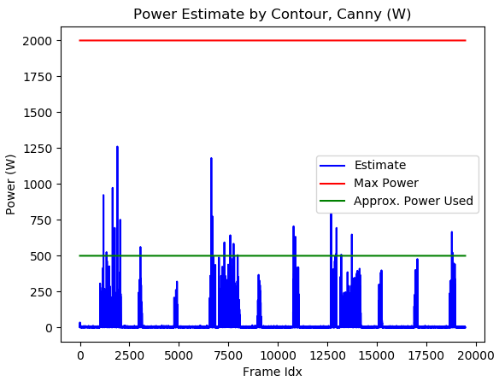
Estimating Laser Power
Using image processing techniques on estimated power density matrix
Designed to work on 2D data
Designed to pickout artifacts
Best estimate uses Canny edge detection to find the laser AOE
Needs improvements
Fourier Transform
Better choice of parameters for analysis
Distance measurements

Slide 8
Current Tasks
Improving power estimate
Writing code to an API
Estimating depth pool
Found paper that uses Stainless Steel 17-4PH to fit a model to data
3D heat transfer modeling for laser powder-bed fusion additive manufacturing with volumetric heat sources based on varied thermal conductivity and absorptivity (2018), Zhang et. al.
Proposes relationship between pool depth and laser power & scanning velocity
Based off repeated runs to build up data
Single tracks
Could be used to approximate depth for Stainless Steel 316L
Verification would require similarly repeated runs
Need more data

